Slide 1
PHP and Ajax
Jon Friskics ©2012

Slide 2
PHP and Ajax
PHP – server-side script
  Script executes on the server
  After execution, client-side script is returned to the browser
    HTML
    CSS
    JavaScript
    XML

Slide 3
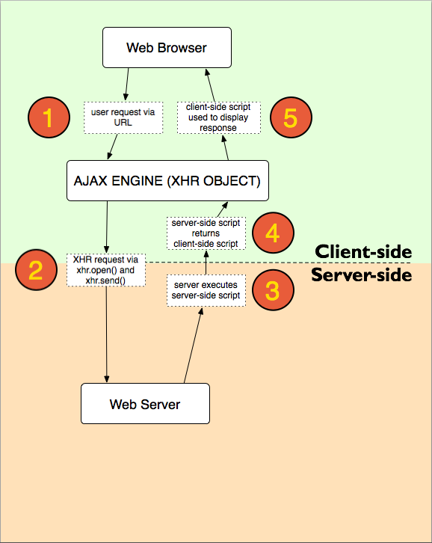

Slide 4
PHP and Ajax
GET
  Since GET doesn’t send any data behind the scenes, we can request a PHP script just like we have been requesting HTML
  We can also send data via GET using query strings
    var qs = "first_name=Jon&last_name=Friskics";
    xhr.open("GET”,"file.php" + ”?" + qs, true);
    xhr.send(null);
    /* this will be requesting
    file.php?first_name=Jon&last_name=Friskics */
  01-26-12/01_ajax_php_get

Slide 5
PHP and Ajax
POST
  POST sends data behind the scenes, so we need to make a few changes
    1. Initiate open() method as POST
      xhr.open("POST”,"file.php",true);

Slide 6
PHP and Ajax
POST
  POST sends data behind the scenes, so we need to make a few changes
    1. Initiate open() method as POST
      xhr.open("POST”,"file.php",true);
    2. Before calling the send() method, call the setRequestHeader() method
      xhr.setRequestHeader("Content-type", "application/x-www-form-urlencoded");

Slide 7
PHP and Ajax
POST
  POST sends data behind the scenes, so we need to make a few changes
    1. Initiate open() method as POST
      xhr.open("POST”,"file.php",true);
    2. Before calling the send() method, call the setRequestHeader() method
      xhr.setRequestHeader("Content-type", "application/x-www-form-urlencoded”);
    3. Pass data (again in query string format) as an argument of the send() method
      var qs = "first_name=Jon&last_name=Friskics";
      xhr.send(qs);

Slide 8
PHP and Ajax
POST
  xhr.open("POST”,"file.php",true);
  xhr.setRequestHeader("Content-type", "application/x-www-form-urlencoded");
  var qs = "first_name=Jon&last_name=Friskics";
  xhr.send(qs);
  01-26-12/02_ajax_php_post

Slide 9
PHP and Ajax
Generating the query string
  The previous examples used pre-defined query strings
  In the real world, data for the query strings will come from user input
  We want to execute the request when the form submit button is activated
    Listen for the submit event on the form object
  01-26-12/03_ajax_simple_form
  01-26-12/04_build_query_string

Slide 10
PHP and Ajax
Generating the query string – a dynamic approach
  JavaScript automatically creates an array object called elements that contains the values of all <input> tags in the form being submitted
  Looping through this elements array and creating a query string dynamically saves lots of time and allows your script to scale
  01-26-12/05_elements_array_query_string

Slide 11
References
Keith, Jeremy. Bulletproof Ajax. Berkeley: New Riders, 2007.
Axelson, Knute. coding: The Handbook for Information Technology. Chicago: Blue Line Press, 2005.
Richards, Robert. Pro PHP XML and Web Services. New York: Apress, 2006.
Notes:
i

